Slide 1

PCWG 2016 Update
20th May 2016
Peter Stuart

Slide 2
PCWG 2016 Roadmap Preparation Process
Online Survey (November 2015)
Online Survey Results Presentation and Group Discussion (December 2015)
Preparation of roadmap based on survey results and discussion (January 2016)
Circulation of Draft Roadmap (February 2016)
Email Feedback (February 2016)
Roadmap Finalised (March 2016)

Slide 3
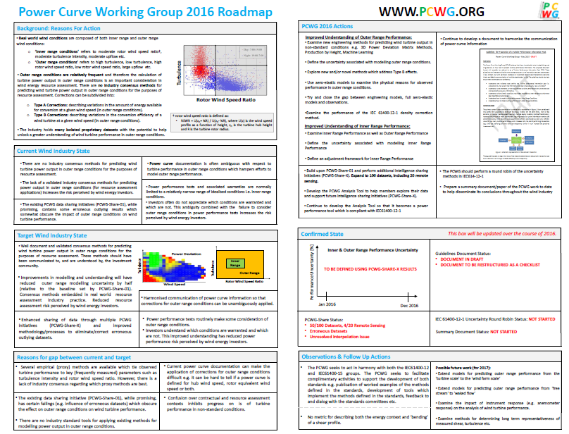

Slide 4
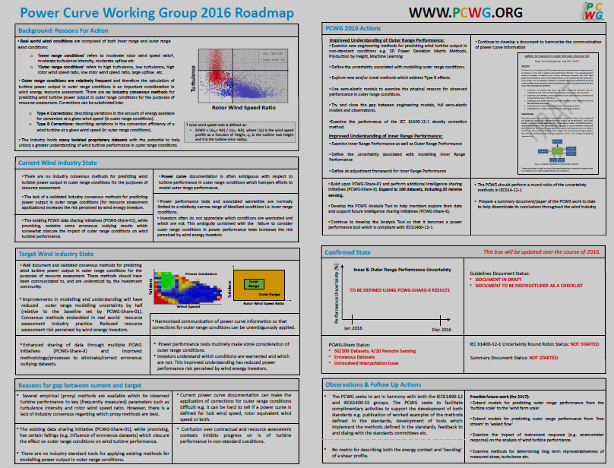
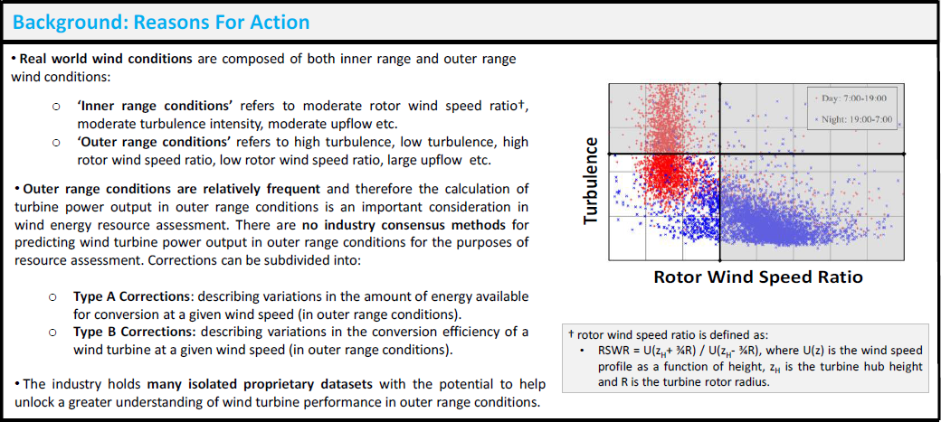

Slide 5
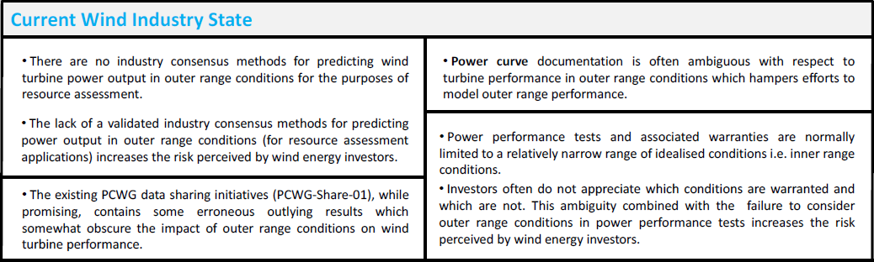

Slide 6
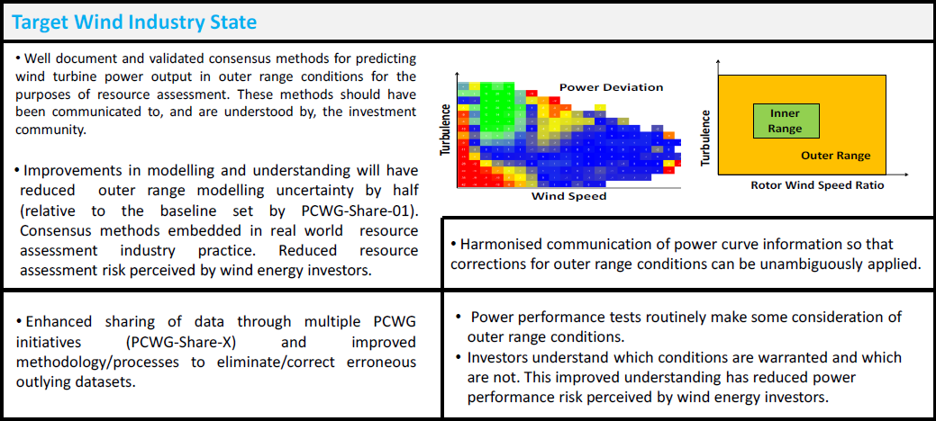

Slide 7
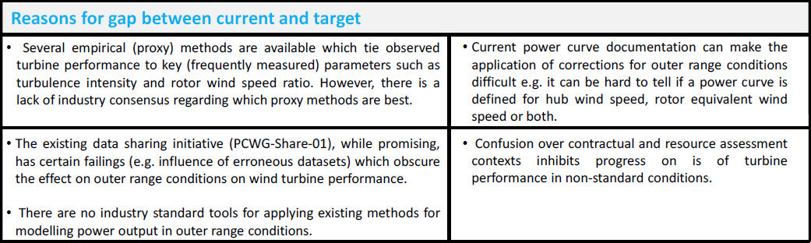

Slide 8
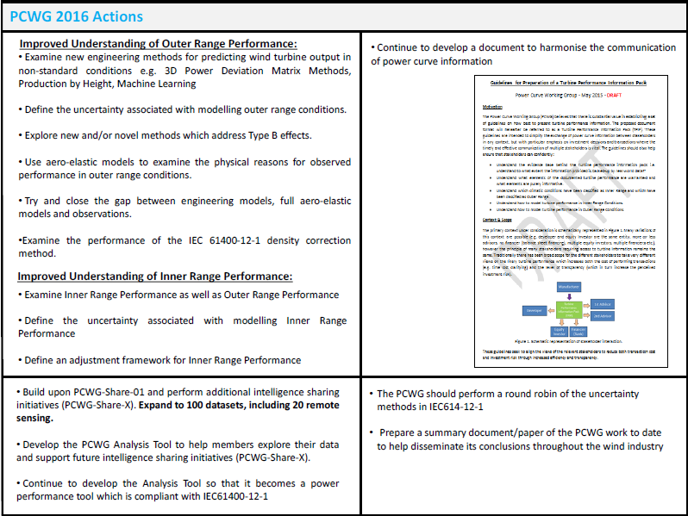

Slide 9
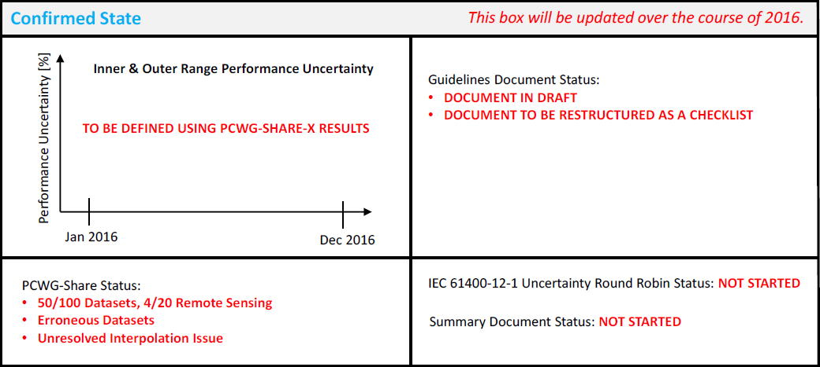

Slide 10
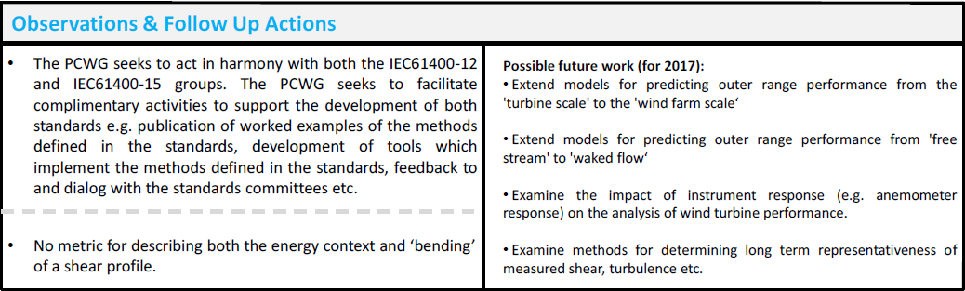

Slide 11
PCWG Intelligence Sharing Initiative

Slide 12
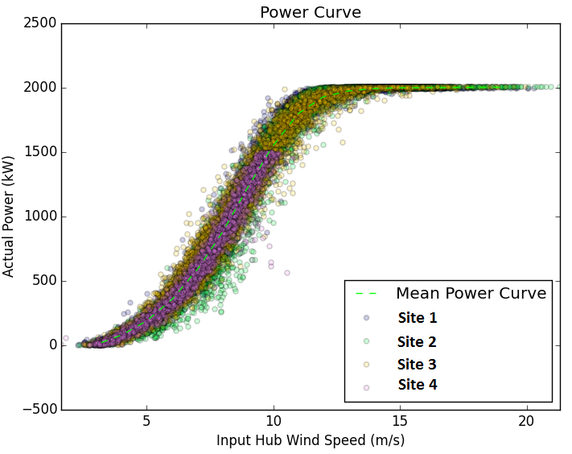
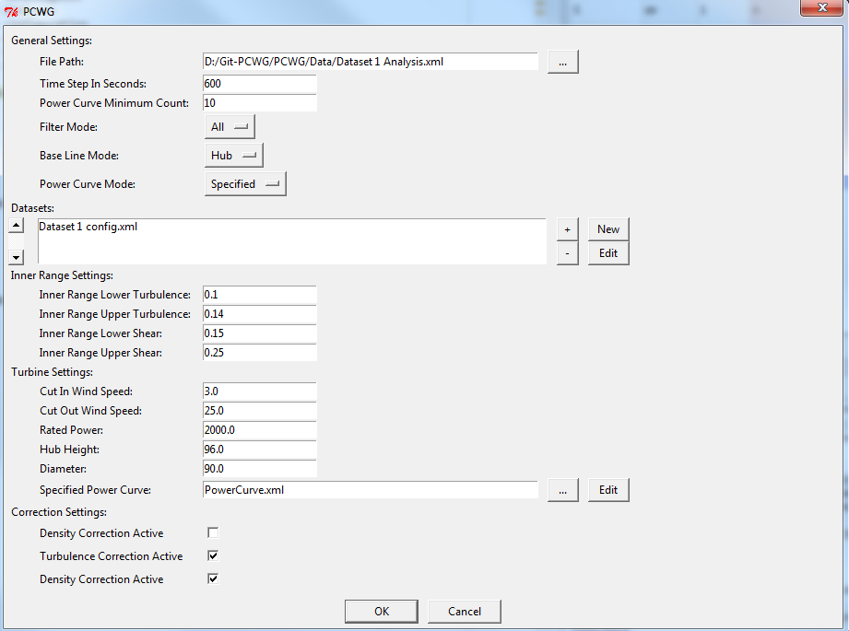
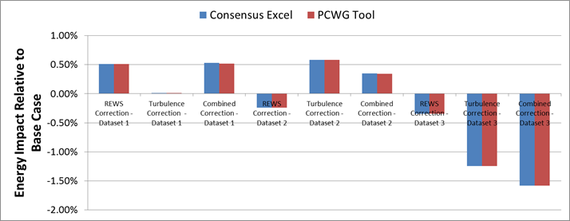
PCWG-Share-01: PCWG Analysis Tool
PCWG-Share-01: Enabled by PCWG Analysis Tool.
Consistent data analysis and anonymous report generation.
‘Just do it’ PCWG-Share-01 button (minimise set-up time)
Excel Benchmark and PCWG Analysis Tool Comparison

Slide 13
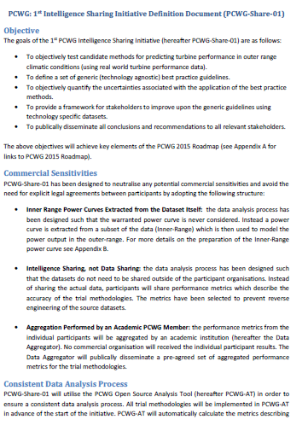
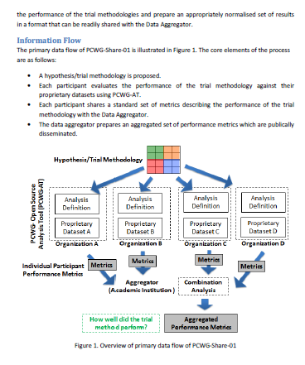
PCWG-Share-01 Definition Document
Download PCWG-Share-01 Definition Doc from www.pcwg.prg

Slide 14
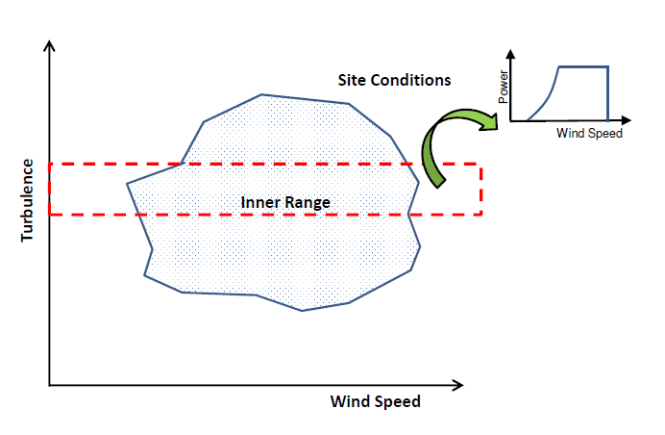
PCWG-Share-01: Neutralising Commercial Sensitivities
Inner Range Power Curves Extracted from the Dataset Itself: the data analysis process has been designed such that the warranted power curve is never considered. Instead a power curve is extracted from a subset of the data (Inner-Range) which is then used to model the power output in the outer-range.
Intelligence Sharing, not Data Sharing: the data analysis process has been designed such that the datasets do not need to be shared outside of the participant organisations. Instead of sharing the actual data, participants will share performance metrics which describe the accuracy of the trial methodologies.

Slide 15
PCWG-Share-01: Data Flow
Hypothesis/Trial Methodology
Analysis Definition Y
Analysis Definition Y
Analysis Definition Y
Analysis Definition Y
Proprietary Dataset A
Proprietary Dataset B
Proprietary Dataset C
Proprietary Dataset D
Organization A
Organization B
Organization C
Organization D
Hypothesis Performance Metrics
Aggregator
(Academic Institution )
Combination Analysis
How well did the trial method perform?
Aggregated Hypothesis Performance Metrics

Slide 16
Many thanks to all PCWG-Share-01 Participants and special thanks to
Andy Clifton of NREL
Join the Power Curve Working Group at: www.pcwg.org

